Slide 1
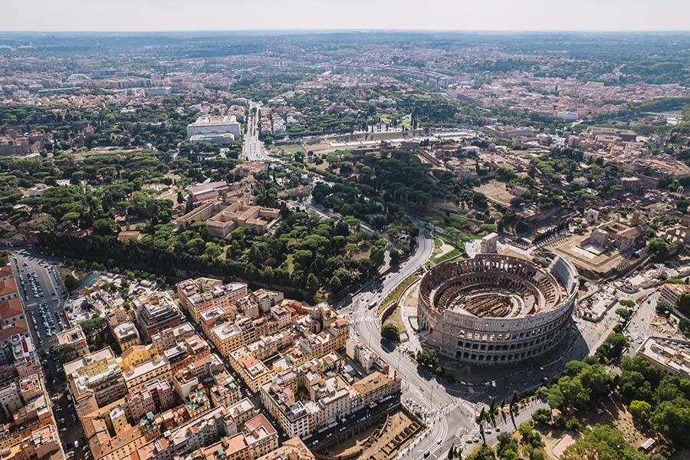
ALGORITHMS FOR DATA SCIENCE
Airbnb Market Radar
Emanuele Bellezza K18722, University of Warsaw

Slide 2
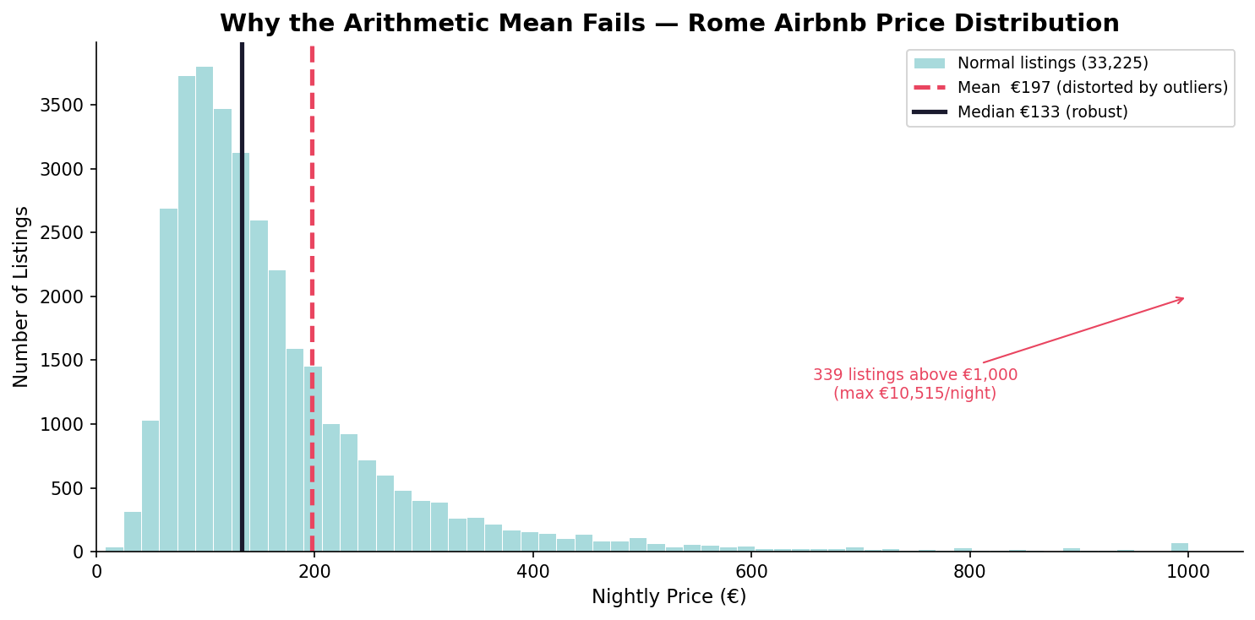
Problem Statement
Pricing for New Hosts
New Airbnb hosts often struggle with pricing their apartments effectively. The traditional arithmetic mean is misleading, especially with outliers. Our goal is to provide an optimal nightly price based on competitors.

Slide 3
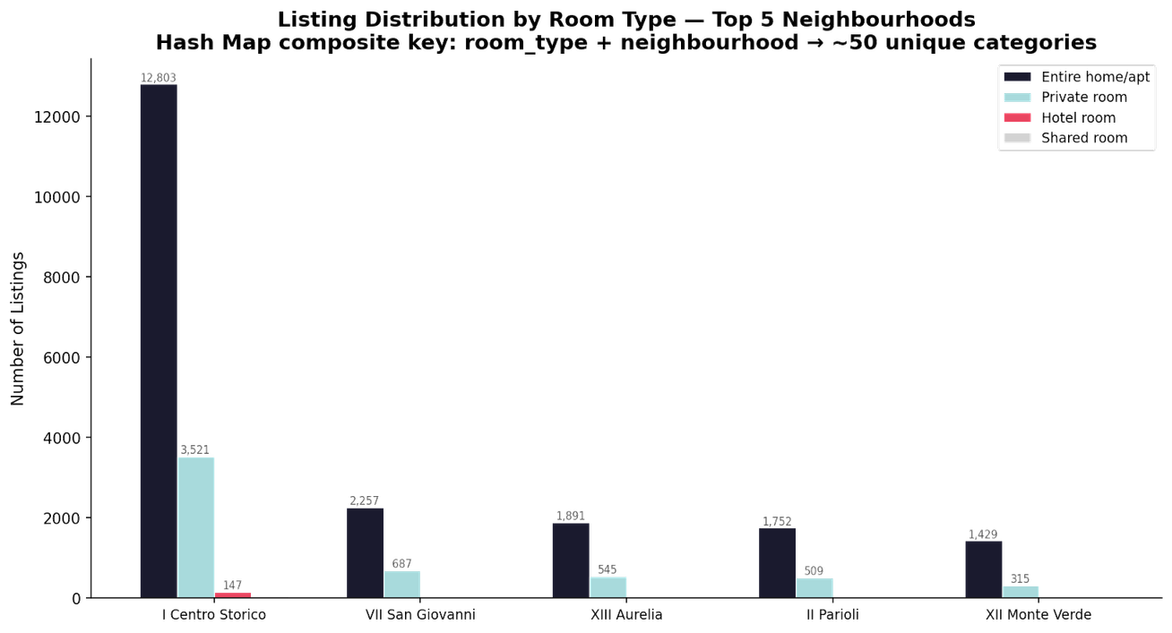
Data Input
Dataset Overview
The dataset consists of 37652 listings from Inside Airbnb Rome, detailing essential fields for accurate nightly price calculations.
Analyzing dataset details and edge cases in pricing
Edge Case 1
Missing prices in 11 percent of listings were identified, necessitating data preprocessing to ensure reliable pricing suggestions.
Edge Case 2
Outliers impacted pricing; thus, a median price was employed instead of the mean to provide a more accurate suggestion.

Slide 4
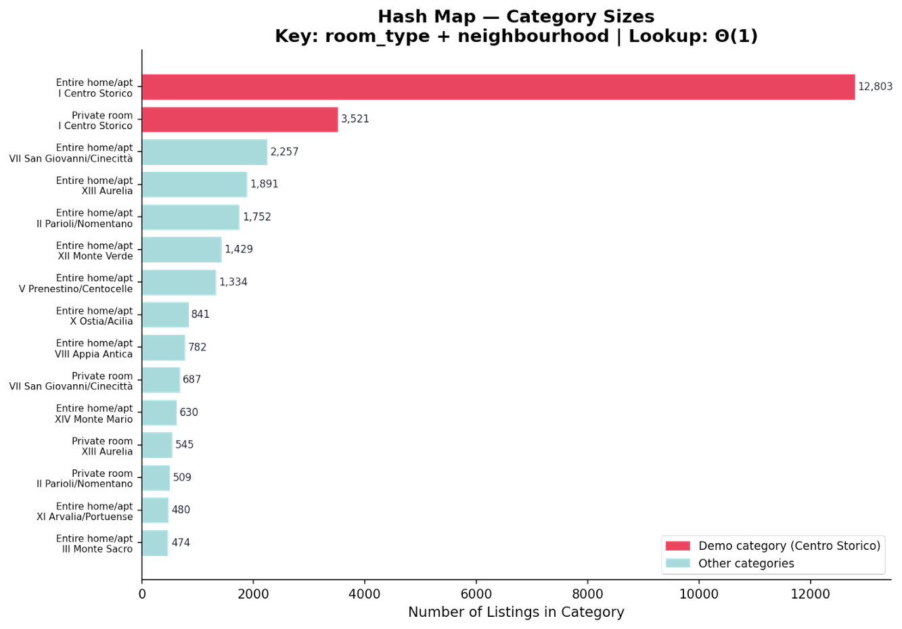
Stage A: Overview
Exploring the Hash Map Logical Filter Process
Input Details
The algorithm begins with 33,564 clean listings, ready for processing to provide relevant competitor data.
Key Composite String
Python dictionary indexed by a composite key. categorizing listings into 60 distinct groups for effective filtering.
Efficiency Justification
With a build time of O(N) and lookup time of Θ(1), the hash map ensures optimal performance compared to a binary search tree.

Slide 5
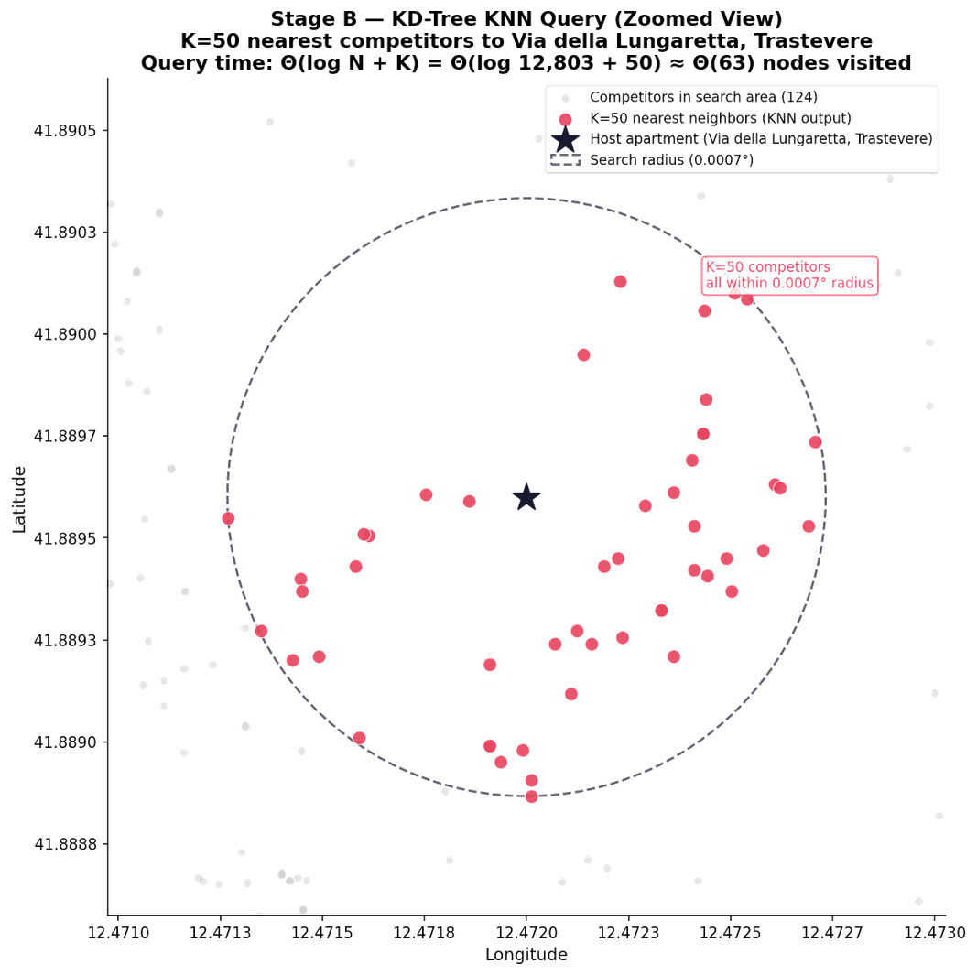
KD-Tree and KNN
Efficient spatial filtering for nightly price suggestions
Input Listings
The KD-Tree utilizes competitor listings to create an optimal spatial representation, enabling efficient price comparisons within geographic boundaries.
Build Time
Building the KD-Tree is a bottleneck due to its O(N log N) complexity, essential for efficient query performance in the pipeline.
Query Efficiency
KNN query time achieves Theta(log N plus K), making it significantly faster than brute force methods, ensuring timely price suggestions.

Slide 6
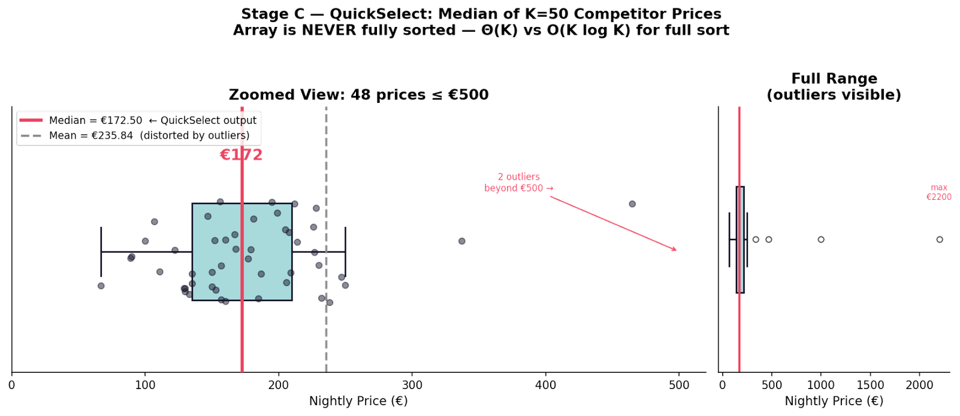
QuickSelect Filter
An efficient approach to determine nightly prices
Space Complexity
The algorithm runs in Theta 1 space, allowing it to process data in place without requiring additional storage.
Input Details
The algorithm utilizes 50 competitor prices from the KD-Tree output to suggest an optimal nightly price efficiently.
Time Complexity
QuickSelect operates in Theta K time on average, making it significantly faster than sorting for K equals 50 competitor prices.

Slide 7
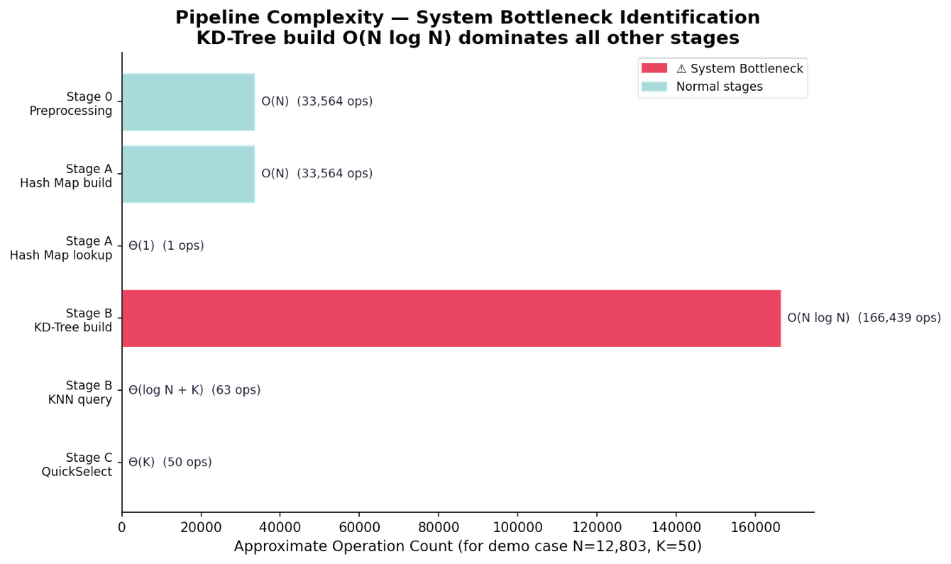
The algorithm pipeline consists of several stages, each with specific time and space complexities:
Preprocessing: O(N) time, O(N) space
Stage A (Hash Map): Build time O(N), lookup time Θ(1)
Stage B (KD-Tree): Build time O(N log N) – bottleneck
Stage B (KNN Query): Query time Θ(log N) + K
Stage C (QuickSelect): Time Θ(K), space Θ(1)
The funnel effect narrows the dataset from 33,564 to 12,803 to 50 and finally to 1 price, justifying the bottleneck of O(N log N) as a one-time cost that facilitates efficient searches.
Architectural Justification

Slide 8
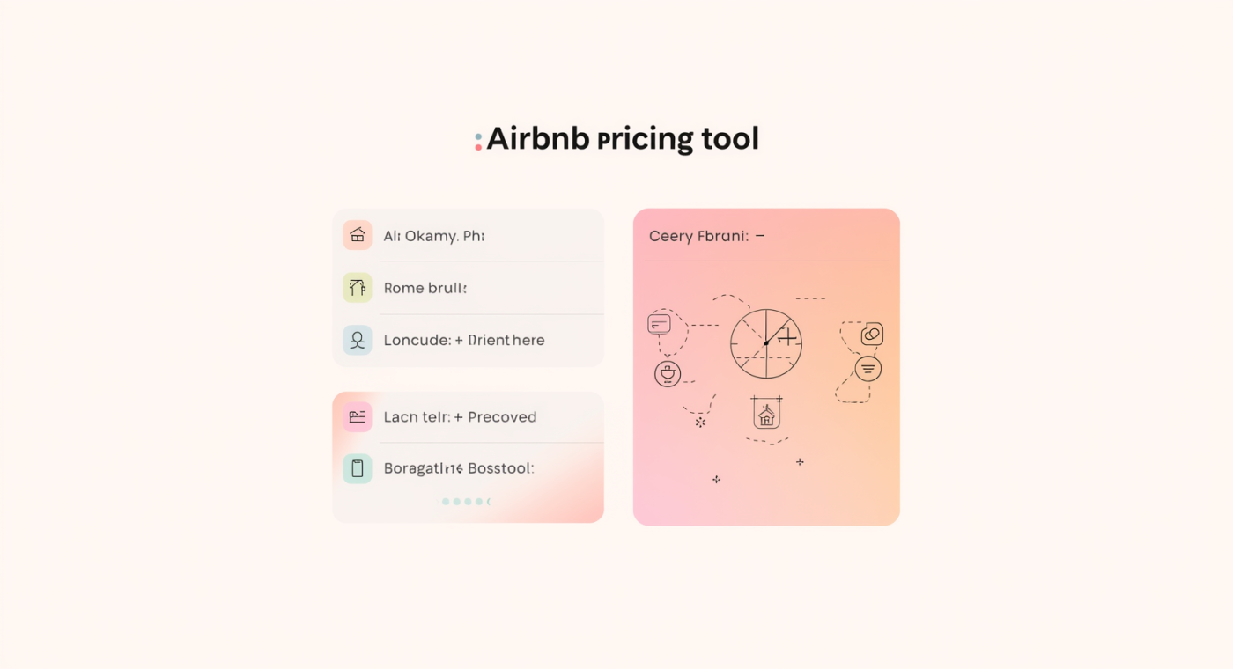
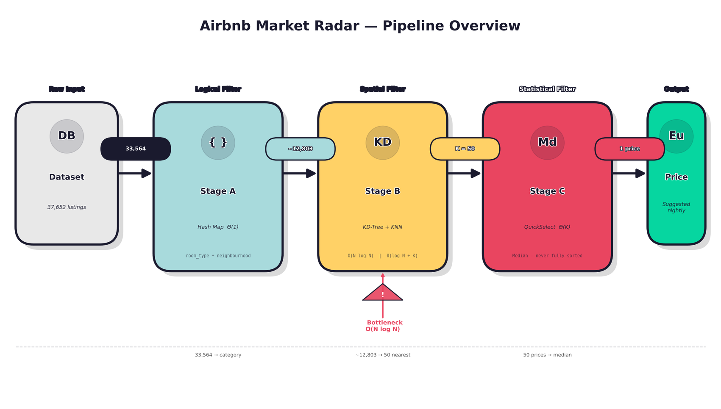
Live Demo Overview
Inputs and Outputs Explained
During the live demo, a host inputs room type, neighborhood, and geographic coordinates to receive a suggested median nightly price based on the algorithm's analysis.

Slide 9
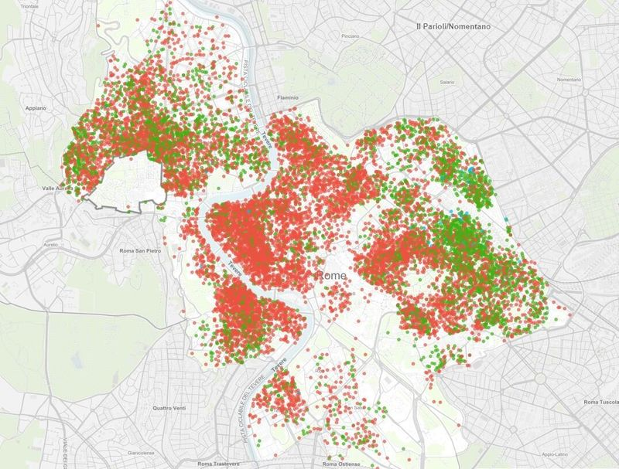
Any Questions About Pricing?

